Slide 1


ADHIYAMAAN COLLEGE OF ENGINEERING (AN AUTONOMOUS INSTITUTION)
Approved by AICTE, Affiliated Anna University accredited by NBA & NAAC with A Grade.
Dr M G R Nagar, Hosur - 635 130, Krishnagiri (Dist.), Tamil Nadu, India.
DEPARTMENT OF ELECTRONICS AND COMMUNICATION ENGINEERING
PROJECT TITLE:
DESIGN AND IMPLEMENTATION OF A BUCKLE-ACTIVATED IOT SMART HELMET FOR AUTONOMOUS ACCIDENT DETECTION AND EMERGENCY ALERTING
PROJECT GUIDE:
Dr. S. Sumathi Professor /HoD Department of ECE
Adhiyamaan College of Engineering
PREPARED BY:
Suganth S.N (6176AC22UEC140)
Thameen Ansari. A (6176AC22UEC150)
Vidyadheesha.M.Pandurangi (6176AC22UEC162)
Yeshwanth. R (6176AC22UEC170)
B.E. ECE “C” – IV Year

Slide 2
INTRODUCTION:
IoT in Wearable Safety Systems
The Internet of Things (IoT) has transformed conventional safety devices into intelligent, connected systems capable of real-time sensing, decision-making, and communication. In the transportation domain—particularly for two-wheeler riders—IoT-enabled wearables play a crucial role in improving accident detection accuracy and reducing emergency response time.
Smart Helmet Technology
A smart helmet integrates sensors, embedded controllers, wireless modules, and communication interfaces to perform continuous monitoring of rider activity and environmental conditions. Modern advancements allow helmets to autonomously detect crashes, track rider movement, and initiate emergency communication without requiring manual intervention.
Relevance to Road Safety
Two-wheeler accidents account for a significant portion of road fatalities. Delay in identifying an accident and notifying emergency services is a major cause of severe injuries. IoT-based smart helmets directly address this challenge by offering fast, automated, and reliable accident recognition and alerting capabilities.

Slide 3

RESEARCH:

Slide 4
ABSTRACT:
This project presents the design and implementation of a buckle-activated IoT Smart Helmet capable of automatically detecting accidents and sending emergency alerts. The system uses an ESP32 microcontroller as the main controller, integrated with an MPU6050 IMU sensor and a vibration sensor to detect sudden impacts, abnormal motion, and high-intensity shocks.
A Hall sensor-based buckle mechanism ensures that the system activates only when the helmet is properly worn, improving safety compliance and reducing unnecessary power consumption. During normal riding, the system operates in low-power monitoring mode. When an accident is detected, the GPS Neo-6M module retrieves real-time location coordinates, and the SIM800L GSM module sends an emergency alert message to predefined contacts.
Additionally, the system verifies rider consciousness through an SMS confirmation before sending the final emergency alert. This energy-efficient and scalable solution enhances rider safety by significantly reducing emergency response time.

Slide 5
OBJECTIVES:
To design and develop an IoT-enabled Smart Helmet capable of autonomously detecting fusion techniques (MPU6050 IMU and vibration sensor).
accidents using sensor
To implement a buckle-activated power control mechanism using a Hall sensor, ensuring the system operates only when the helmet is securely worn.
To optimize energy efficiency by incorporating an intelligent low-power standby mode with selective activation of GSM and GPS modules.
To enable real-time emergency alert generation by integrating GPS-based location tracking (Neo-6M) and GSM communication (SIM800L).
To significantly reduce emergency response time and enhance rider safety by ensuring timely medical assistance during accidents.

Slide 6
LITERATURE SURVEY:
Kumar & Raj (2020) developed an IoT-based smart helmet using motion sensors and GSM for real-time accident detection and automated emergency alerts.
Verma et al. (2020) proposed a GPS and GSM-based accident alert system, but it was vehicle-mounted and lacked wearable integration.
Hossain & Muhammad (2021) designed an IoT helmet using MEMS sensors and sensor fusion techniques to improve crash detection accuracy.
Bhoi & Khilar (2018) introduced a smartphone-based accident detection system with cloud communication, but it depends on phone availability.
Patel & Shah (2019) implemented a threshold-based accelerometer accident detection system with GSM alerts, though without false alarm verification.
Reddy & Lakshmi (2020) proposed a smart helmet integrating alcohol detection and accident notification features for enhanced rider safety.
Zhang et al. (2021) demonstrated that MEMS accelerometer and gyroscope integration significantly improves motion analysis reliability.
Chauhan & Thakur (2022) developed an ESP32-based IoT accident detection system with GPS tracking and efficient wireless communication.
Alaa et al. (2023) reviewed intelligent accident detection systems and emphasized the need for verification mechanisms to reduce false positives.
Shinde & Patil (2024) proposed a GSM and GPS-based two-wheeler accident detection system but lacked a confirmation stage before sending alerts.

Slide 7
EXSISTING METHODOLOGY:
Existing Methodology Issues / Drawbacks
Accident detection typically relies on a single accelerometer Cannot detect rider-specific impact; low crash recognition mounted on the motorcycle rather than on the rider. accuracy.
System remains continuously powered ON, regardless of helmet usage.
Causes unnecessary battery drain; unsuitable for long-term wearable use.
On detecting an impact, system directly sends emergency SMS to saved contacts.
No rider confirmation → high chances of false alerts.
Location data is taken from basic GPS or user smartphone.
Dependent on mobile phone availability; may produce inaccurate coordinates.
No check to determine if the rider is conscious or safe after the event.
Minor bumps or non-critical events may trigger emergency alerts.
Helmet does not have a power control mechanism connected to wearing status.
System may trigger alerts even when helmet is idle/not worn.
Many systems rely on manual SOS activation by the rider.
Ineffective when the rider is unconscious or unable to operate the system.

Slide 8
PROPOSED SYSTEM:
The Smart Helmet architecture is designed as a modular, layered embedded system enabling separation of sensing, processing, communication, and power management functionalities.
A. Sensing Subsystem
The MPU6050 IMU provides six degrees of freedom (3-axis accelerometer and 3-axis gyroscope). Real-time acceleration data are sampled via I²C communication. Gyroscopic data assist in detecting abnormal orientation changes, complementing acceleration-based detection. Sensor fusion techniques can optionally be applied to enhance motion classification accuracy.
B. Processing Subsystem
The ESP32 microcontroller performs real-time acquisition, digital filtering, threshold comparison, and state transition management. Its dual-core architecture enables efficient task allocation between sensor sampling and communication handling. Interrupt-driven design ensures minimal processing latency.
C. Communication Subsystem
The SIM800L GSM module operates over standard cellular infrastructure, enabling SMS transmission independent of internet connectivity. The GPS Neo-6M module computes latitude and longitude using satellite trilateration. Location data are embedded

Slide 9
D. Power Management Subsystem
A Hall-effect sensor detects helmet fastening through magnetic proximity. Upon activation, the FQPF27P06 P-channel MOSFET enables high-side power delivery to the ESP32 and peripheral modules. Boost and buck converters regulate voltage levels for stable operation. The TP4056 charging module ensures safe Li-ion battery charging using constant-current/constant-voltage methodology.
This architecture ensures that the sensing and communication subsystems are energized only during active use, significantly reducing idle energy consumption.
Advantages Over Existing Methodology:
Automatically detects accidents using multi-sensor fusion without requiring manual activation.
Ensures immediate emergency response even if the rider is unconscious.
Buckle-activated mechanism ensures the system operates only when the helmet is worn.
Improves safety compliance and reduces unnecessary power consumption.
Combines accelerometer, gyroscope, and vibration sensing to minimize false alarms.
Provides more accurate crash detection compared to single-sensor systems.
Sends real-time GPS location via GSM-based SMS without internet dependency.
Ensures reliable emergency communication even in remote areas.
Implements intelligent power management with standby mode and selective module activation.
Extends battery life and enhances overall system efficiency.

Slide 10
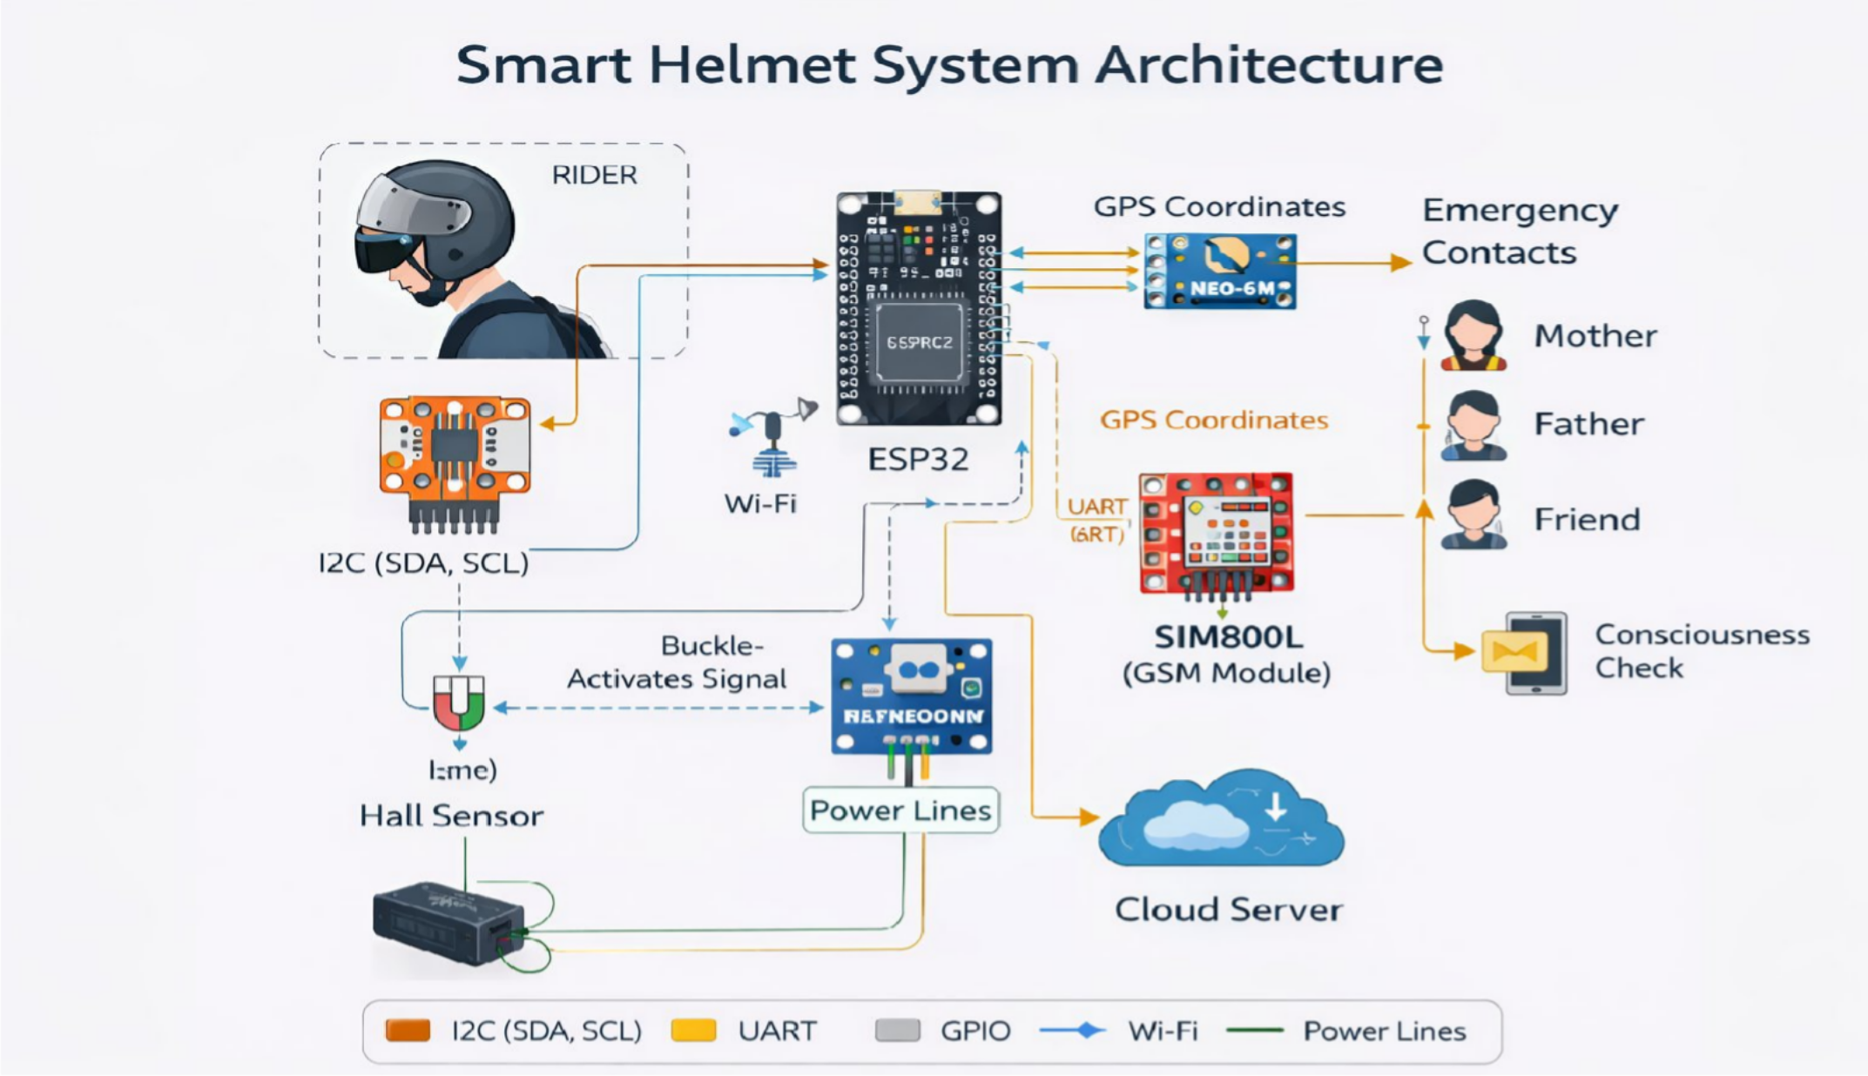
ARCHITECTURE:

Slide 11
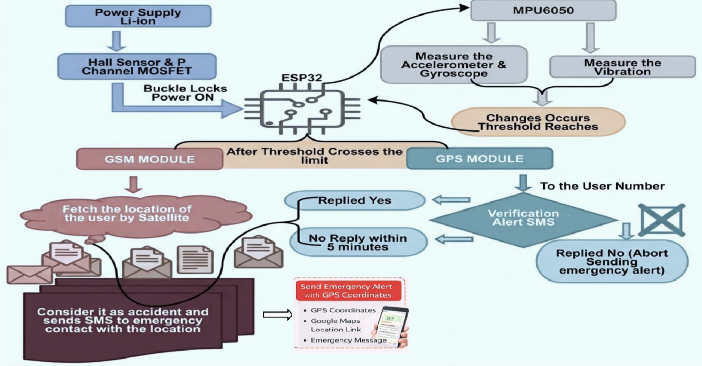
METHODOLOGY:
Flowchart

Slide 12
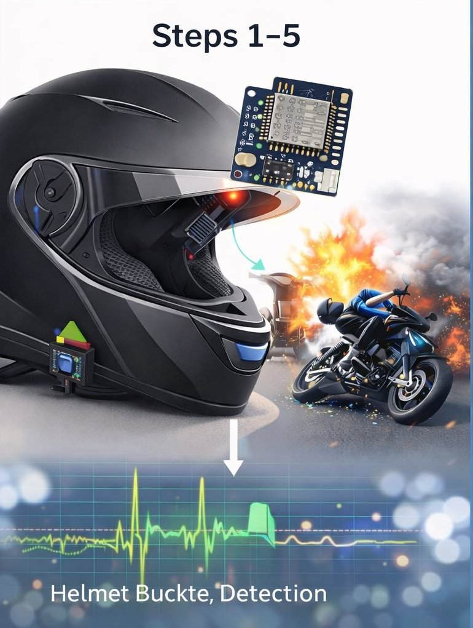
Step-1: Helmet Wear Detection
The Hall-effect sensor checks whether the helmet buckle is fastened.
If not buckled, the system remains OFF (ultra-low power mode).
Step-2: System Activation
When the helmet is buckled, power is supplied to the ESP32 and sensors.
The MPU6050 IMU and vibration sensor are initialized.
Step-3: Continuous Monitoring
The ESP32 continuously reads acceleration, tilt, and vibration data.
Real-time motion data is processed using threshold comparison.
Step-4: Abnormal Motion Detection
If sudden impact, high G-force, or abnormal tilt is detected,
The system flags a potential accident condition.
Step-5: Accident Verification
The ESP32 performs threshold validation to avoid false alarms.
If values exceed predefined crash limits, accident is confirmed.

Slide 13
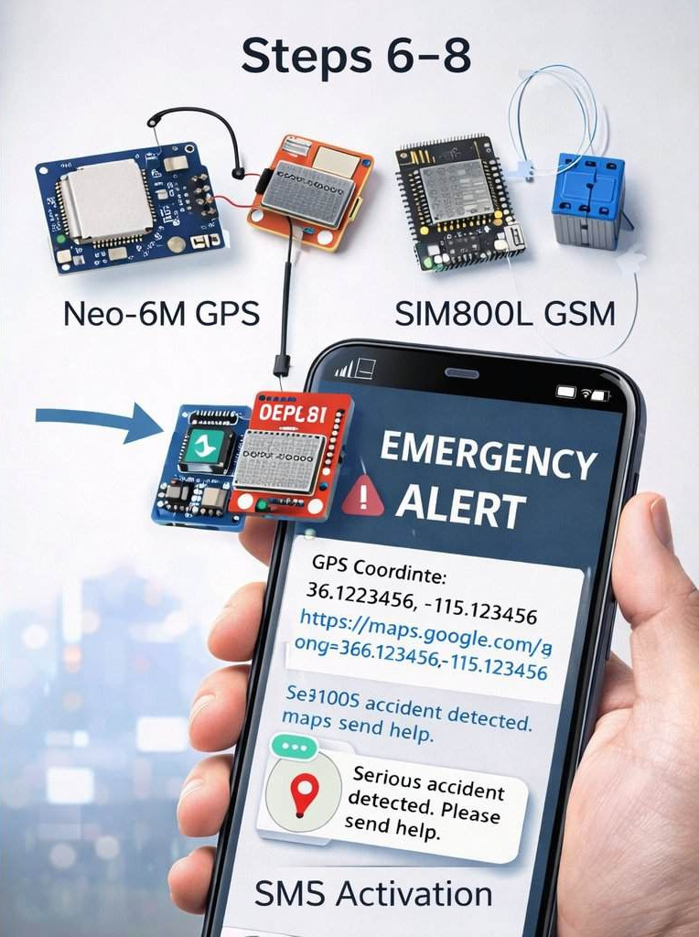
Step-6: GPS Activation
The Neo-6M GPS module is powered ON.
Real-time latitude and longitude coordinates are acquired.
Step-7: Consciousness Check
The SIM800L GSM module sends an SMS to the rider.
The rider is given a short time window to respond.
Step-8: Emergency Alert
If no response is received,
The system automatically sends an emergency SMS with GPS location (Google Maps link).
Step-9: Notification to Contacts
Emergency contacts receive accident details and live location.
Quick response and medical assistance can be initiated.

Slide 14
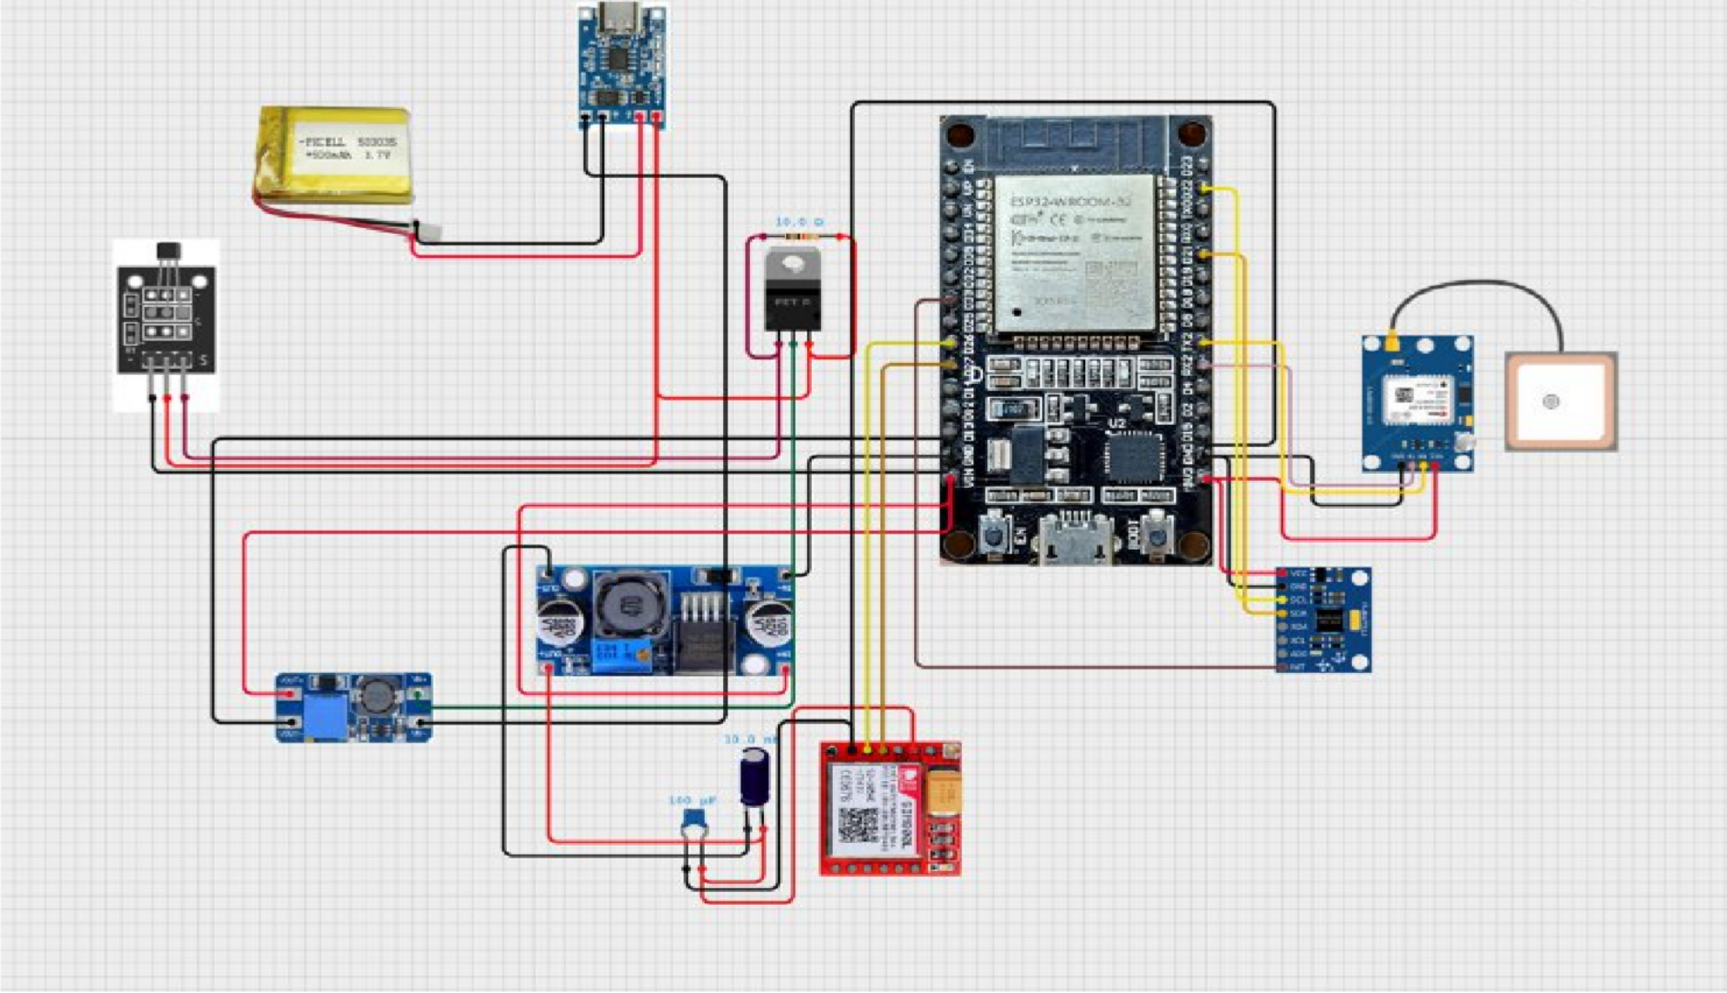
CIRCUIT DIAGRAM

Slide 15
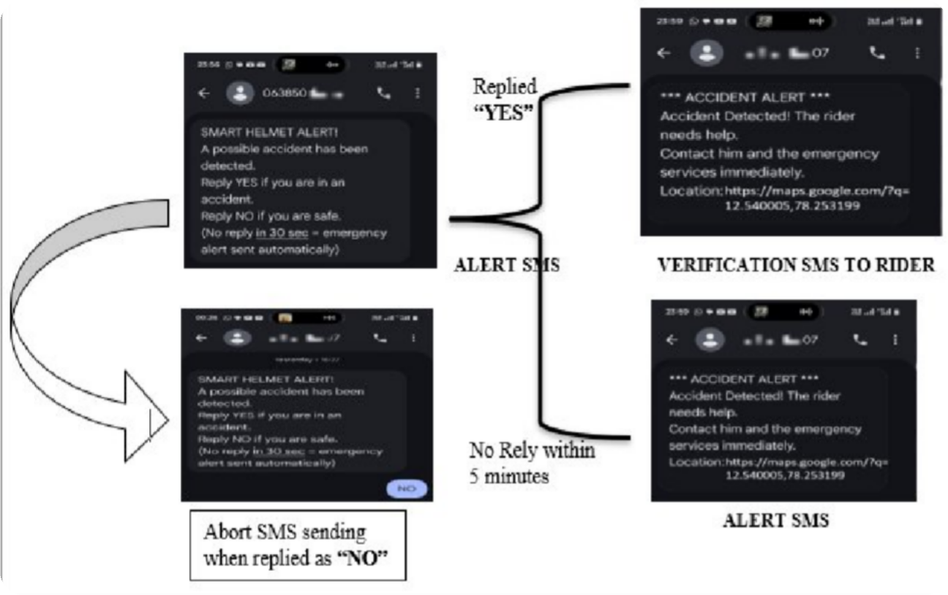
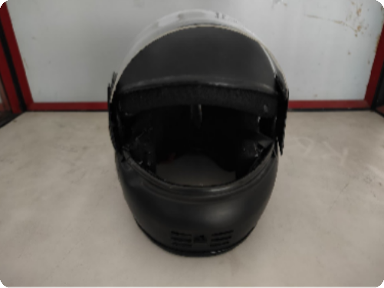
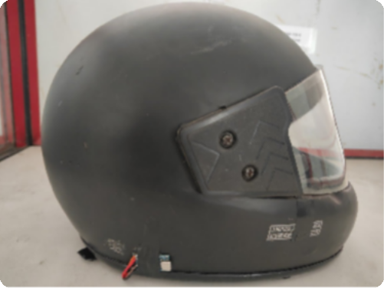
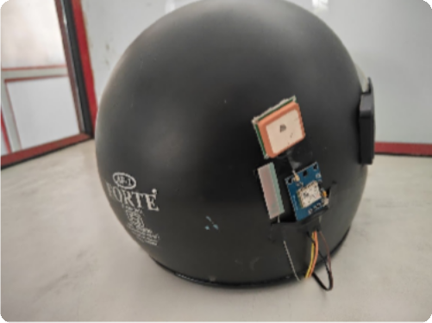
OUTPUT IMAGE’s
HELMET OUTER VIEW
FRONT VIEW
SIDE VIEW
SMS ALERT TO THE EMERGENCY CONTACT & VERFICATION ALERT TO THE USER
REAR VIEW

Slide 16
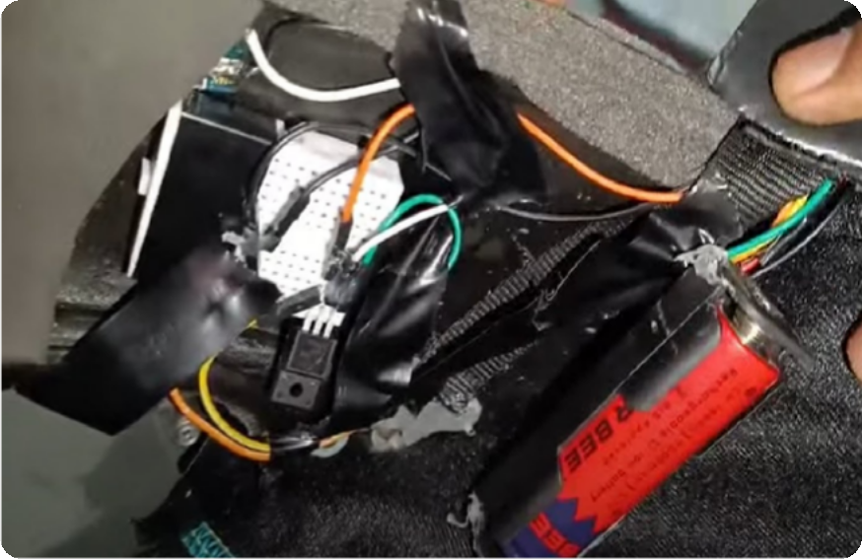
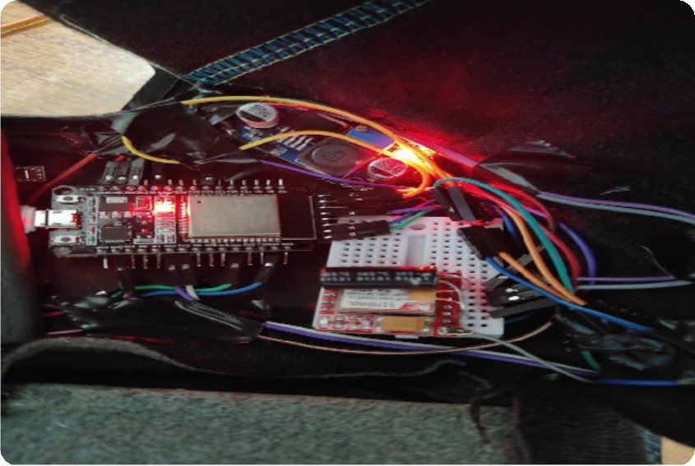
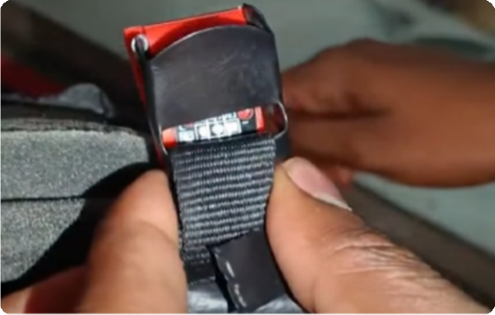
SYSTEM INNER VIEW
BATTERY MANAGEMENT SYSTEM & POWER SUPPLY
MICROCONTROLLER & SENSORS INSIDE HELMET VIEW
HALL SENSOR – BUCKLE ACTIVATION

Slide 17

PROJECT DEMO VIDEO

Slide 18

TOOLS FOR IMPLEMENTATION:
Hardware Tool | Justification / Purpose in Project
ESP32 Microcontroller | Acts as the central processing unit, handling sensor data processing, accident detection logic, GPS acquisition, and GSM communication.
MPU6050 (Accelerometer + Gyroscope) | Detects sudden acceleration, tilt changes, and abnormal motion patterns to identify possible accidents.
Vibration Sensor Module | Senses high-impact shocks and collision forces to support accurate crash detection.
Neo-6M GPS Module | Provides real-time latitude and longitude coordinates for precise accident location tracking.
SIM800L GSM Module | Sends emergency SMS alerts with GPS location to predefined contacts without requiring internet connectivity.
Hall-Effect Sensor | Detects helmet buckle fastening to ensure the system activates only when the helmet is worn.
Li-ion Battery (3.7V) | Supplies portable and rechargeable power for standalone helmet operation.
TP4056 Charging Module | Ensures safe and efficient battery charging using constant-current/constant-voltage method.
Boost/Buck Converter | Regulates voltage levels to provide stable power supply to all components.
P-Channel MOSFET | Enables high-side power switching for intelligent energy management and reduced power consumption.

Slide 19

TOOLS FOR IMPLEMENTATION:
Tools / Components | Justification
Arduino IDE / PlatformIO | Used for firmware development, code uploading, and debugging due to its extensive library support and compatibility with ESP32.
Embedded C / MicroPython | Programming languages used to implement sensor reading, accident-detection logic, GPS parsing, GSM communication, and power management.
Sensor and Communication Libraries (TinyGPS++, MPU6050, GSM libraries) | Simplify interfacing with hardware modules, reduce development time, and ensure reliable parsing of sensor and communication data.

Slide 20


TOOLS FOR IMPLEMENTATION:
SOFTWARE USED:
Software Tool | Justification
Arduino IDE | Open-source, beginner-friendly platform with wide support for ESP32 and hardware libraries.
Twilio API | Enables instant SMS delivery via cloud; eliminates GSM hardware needs, offers delivery tracking, and scales well.
ADDITIONAL UTILITIES:
Tool/Resource | Justification
I2C Protocol | Minimizes GPIO usage by allowing multiple devices (e.g., LCD) to communicate over a two-wire interface, simplifying hardware design.
Wi-Fi Connectivity | Leverages ESP32’s built-in Wi-Fi to enable seamless, real-time communication with Twilio’s cloud API without extra modules.
C/C++ Programming | Offers low-level control over hardware, efficient memory management, and real-time execution necessary for embedded applications.

Slide 21
BASE PAPER REFERENCE:
Base Paper: "Smart Helmet Using Accelerometer and GSM for Accident Detection and Reporting"
Authors: Shinde, Patil & Kulkarni (2021) – International Journal of Emerging Technologies and Innovative Research Citation: Shinde, S., Patil, A., & Kulkarni, R. (2021). Smart Helmet Using Accelerometer and GSM for Accident Detection and Reporting. International Journal of Emerging Technologies and Innovative Research, 8(6), 45–52.

Slide 22
BASE PAPER REFERENCE:
Relevance of the Base Paper to the Proposed System
Aspect | Shinde et al., 2021 (Base Paper) | Proposed Idea (Your Smart Helmet)
Activation Mechanism | System always ON | Buckle-activated power control ensuring operation only when helmet is worn
Sensor Use | Single accelerometer sensor | Sensor fusion: MPU6050 (IMU) + Vibration Sensor
Accident Detection Accuracy | Basic impact detection | High accuracy using tilt, acceleration, and vibration analysis
Power Management | No power optimization | Ultra-low-power standby mode + selective module activation
Location Tracking | Basic GPS-based reporting | GPS module activated only after detection for power efficiency
Alert Mechanism | Direct SMS alert | Rider verification + SMS with live location
False Alert Handling | No filtering / confirmation | Automatic YES/NO confirmation message before sending emergency alert
Communication Technology | GSM-based SMS only | GSM + intelligent decision logic for autonomous alerting
System Reliability | Moderate | High due to multi-sensor fusion + verification + controlled power states

Slide 23
REFERENCES:
1.
1.R. Kumar and S. Raj, “Design and Implementation of IoT-Based Smart Helmet for Accident Detection,” Int. J. Eng. Res. Technol. (IJERT), 2020.
A. Verma, P. Singh, and K. Sharma, “Accident Detection and Emergency Alert System Using GPS and GSM Module”, Int. Journal of Computer Applications, 2020.
M. S. Hossain and G. Muhammad, “IoT-Based Intelligent Helmet for Accident Detection and Rider Safety,” IEEE Access, vol. 8, pp. 123456–123465, 2021.
S. K. Bhoi and P. M. Khilar, “Vehicular Accident Detection and Notification System Using Smartphone and Cloud,” in Proc. IEEE Int. Conf. Pervasive Computing and Communications Workshops, pp. 547–552, 2018.
R T. Patel and D. Shah, “Real-Time Accident Detection Using Accelerometer and GSM Technology,” Int. Conf. Smart Computing and Electronic Enterprise (ICSCEE), pp. 1–6, 2019.
K. S. Reddy and V. Lakshmi, “Implementation of Smart Helmet with Alcohol Detection and Accident Notification,” Int. J. Emerging Technologies and Innovative Research, vol. 7, no. 5, pp. 210–215, 2020.
Y. Zhang, L. Wang, and H. Sun, “Sensor-Based Intelligent Transportation Safety Monitoring Using MEMS Technology,” IEEE Trans. Intelligent Transportation Systems, vol. 22, no. 4, pp. 2150–2159, 2021.
P. Chauhan and R. Thakur, “IoT-Based Road Accident Detection and Tracking System Using ESP32,” in Proc. Int. Conf. Advances in Electronics, Communication and Computing, pp. 320–325, 2022.
M. Alaa, A. Zaidan, and B. Zaidan, “A Review on Intelligent Accident Detection Systems in Vehicular Networks,” Sensors (MDPI), vol. 23, no. 4, pp. 1–18, 2023.
S. N. Shinde and P. Patil, “Design of GSM and GPS Based Accident Detection System for Two-Wheelers,” Int. J. Advanced Research in Electrical, Electronics and Instrumentation Engineering, vol. 12, no. 2, pp. 89–96, 2024
2.
3.
4.
5.
6.
7.
8.
9.
10.

Slide 24
THANK YOU

